Slide 1

Tethered Overscene Camera Abdullah AlMuhaideb Ademide Ajose Pratik Vijay Toshniwal Praveen Kumar Venkatesan Sandheep Sridar

Slide 2
Outline
Introduction
Technology Description
Analysis
Recommendation

Slide 3
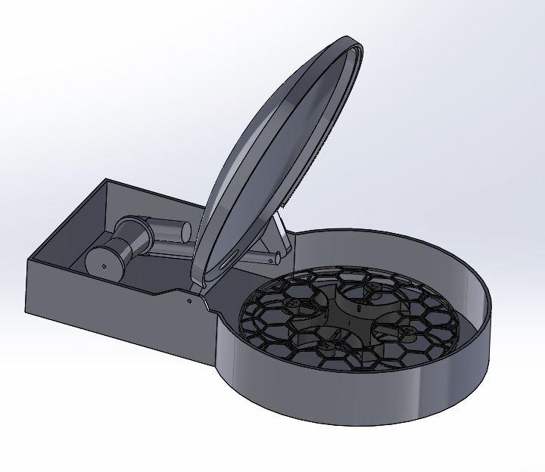
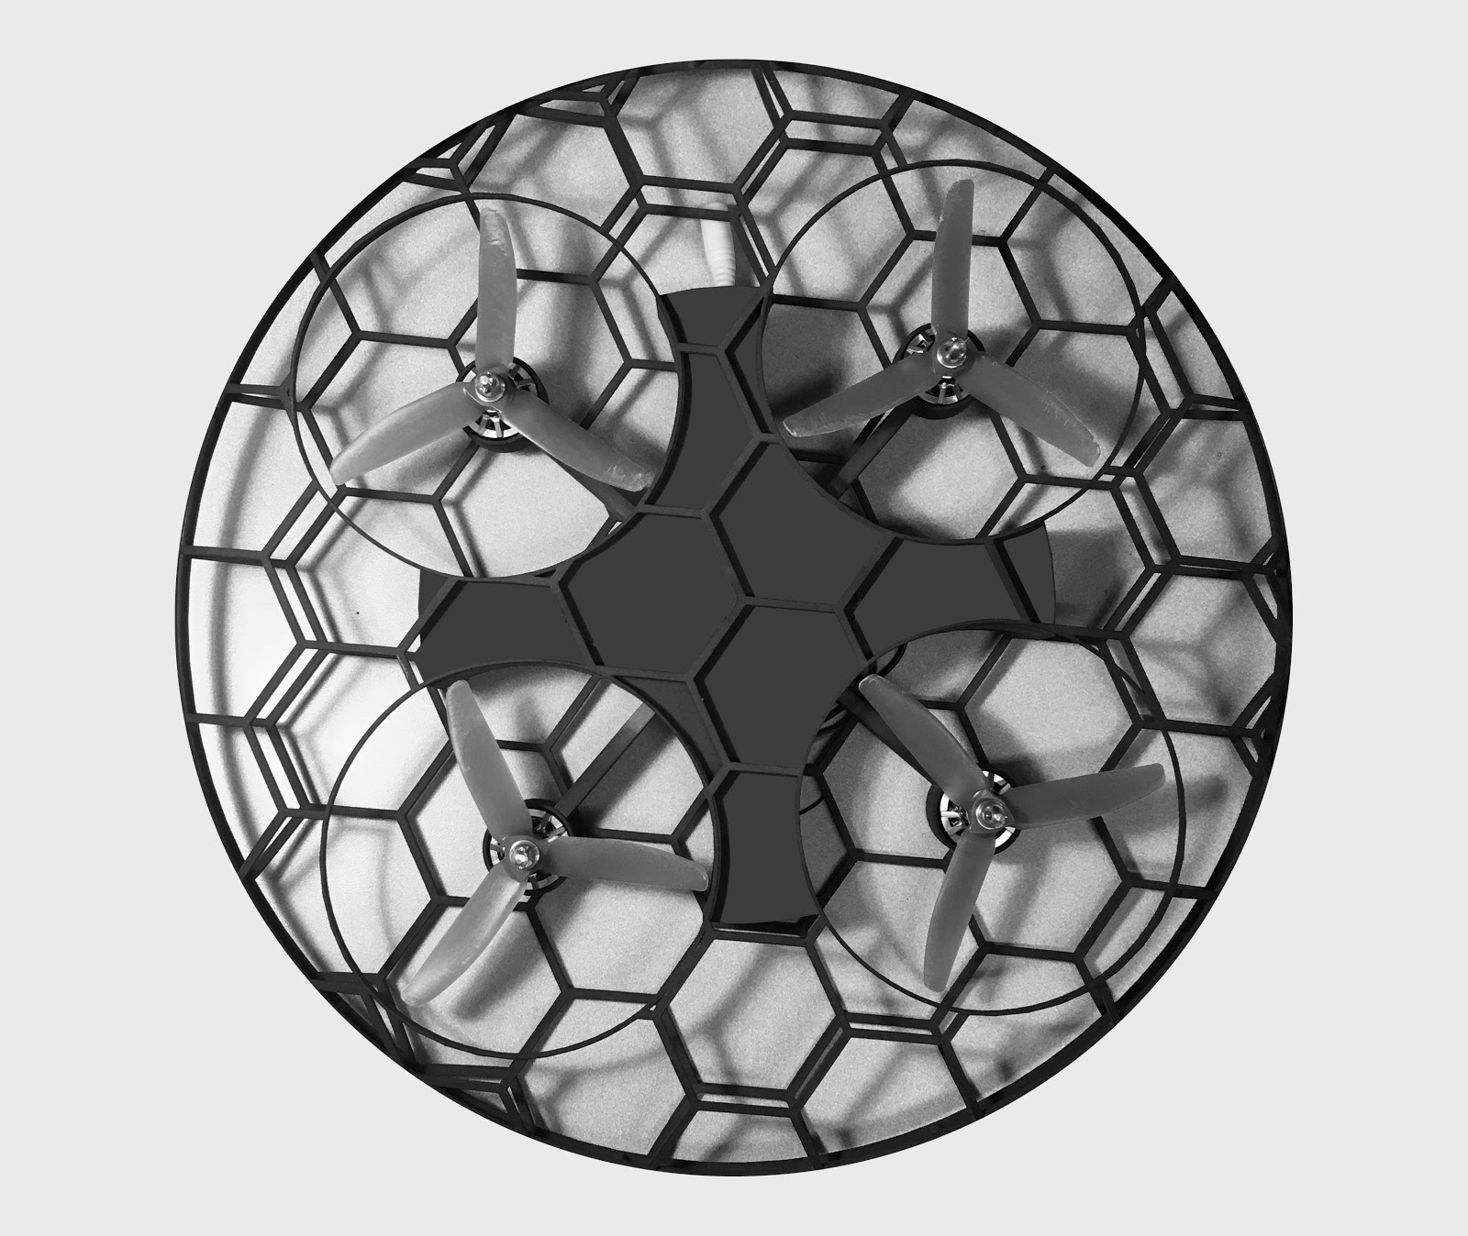
Technology Description - TOC

Slide 4
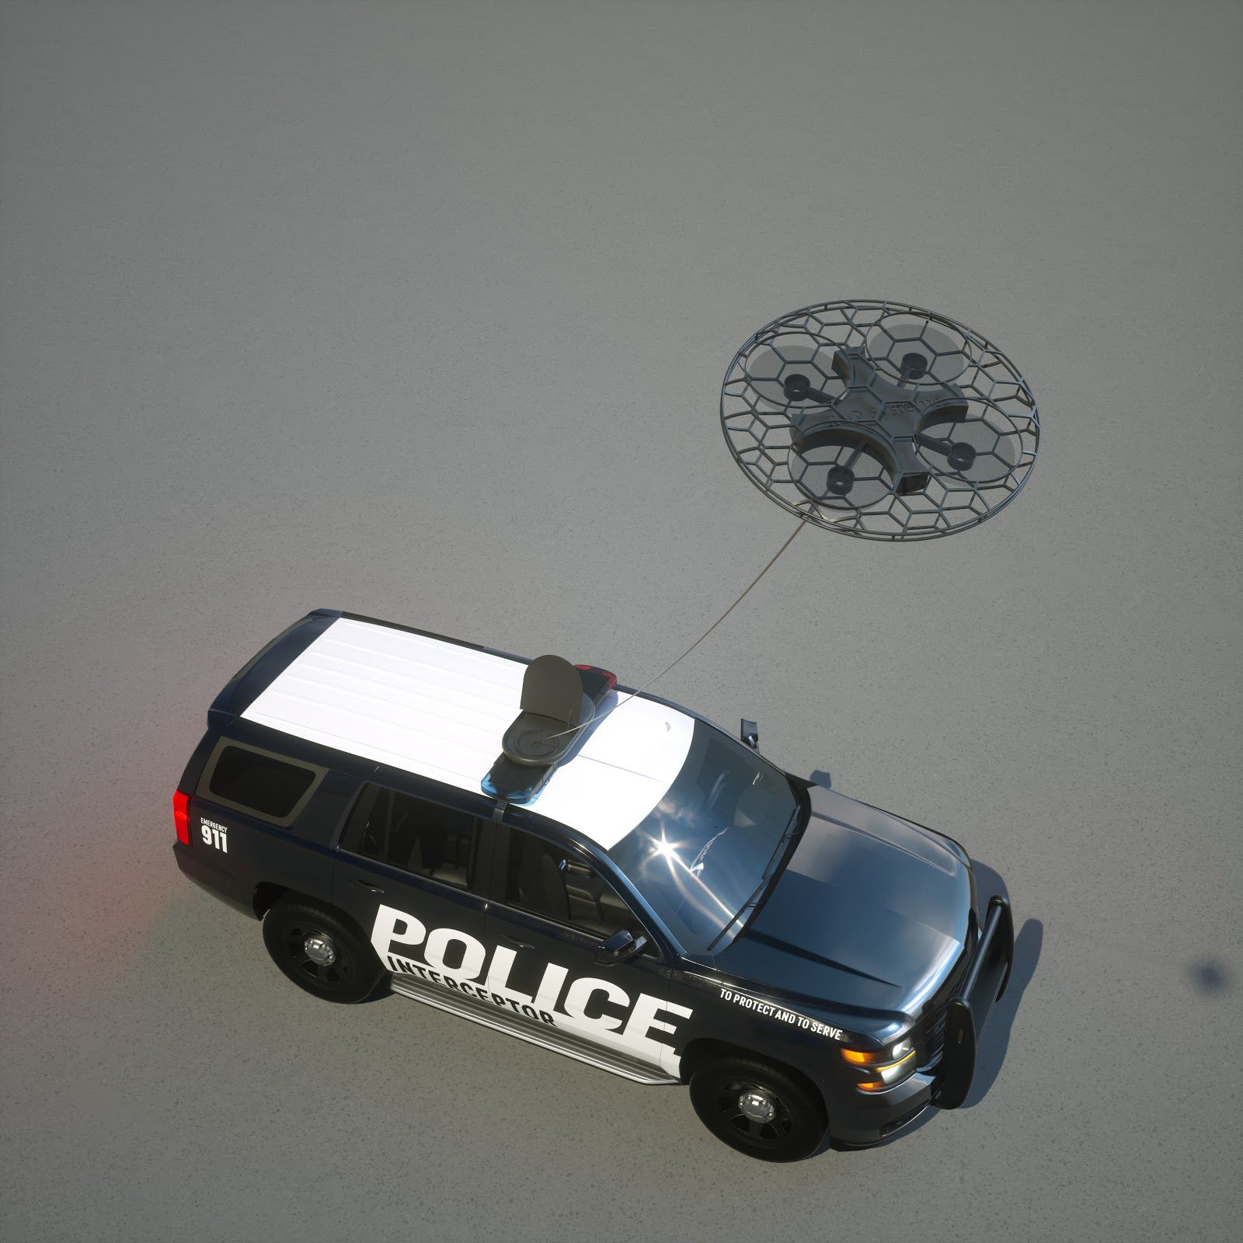
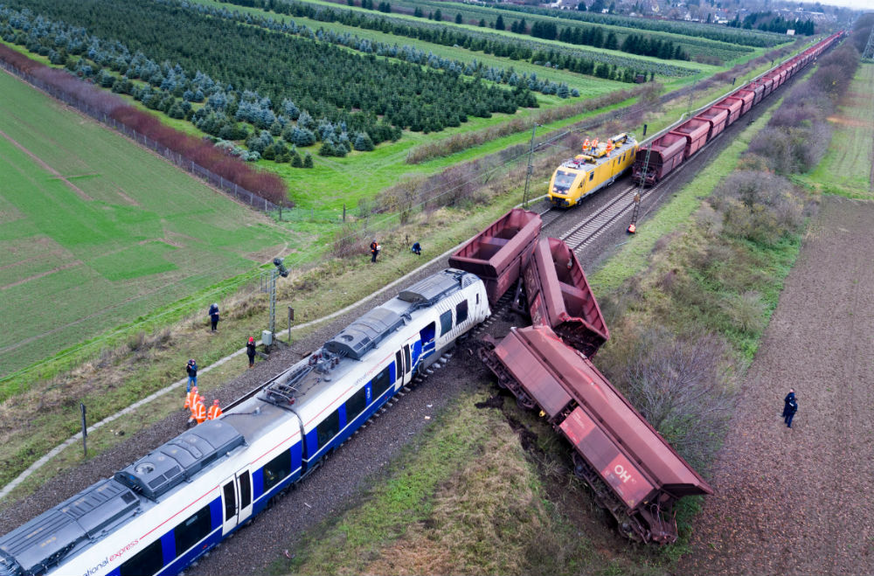
Technology Description - TOC

Slide 5
Patent Status of the Technology
Three patents has been filed
“Vehicle-Based Deployment of a Tethered Surveillance Drone”. (US 16/046,721 Pending)
“Tethered Drone System with Surveillance Data Management” (US 16/046,691 Pending)
This patent has been approved for an expedite processing
“Stability Systems for Tethered Unmanned Aerial Vehicles” (US 15/912,130 Pending)
There are two patents that are under development
“Tracking Systems for Tethered Unmanned Aerial Vehicles”
“Illumination for Tethered Unmanned Aerial Vehicle”

Slide 6
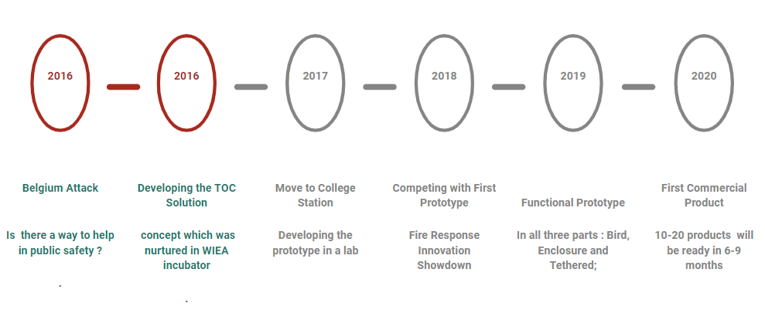
Development Status of the Technology

Slide 7
Potential Benefits and Drawbacks
Benefits include
Originality of the crime scene
Can be quickly adopted seamlessly
360 degree view
Drawbacks are
Security constraints
Lack of data transmission

Slide 8
Competing Technologies and Competitors
Aventura, Black Mamba, BrickHouse Security, Brimtek, COBAN leading law enforcement technology companies
The most notable tethered drone camera in the market is Elistair drones
Hover fly tech is a company which is developing tethered drones similar to TOC
TOC is different from these products because they are comparatively cheaper and they are developing technology to mount these drones on cars and not sell them as a separate device.

Slide 9
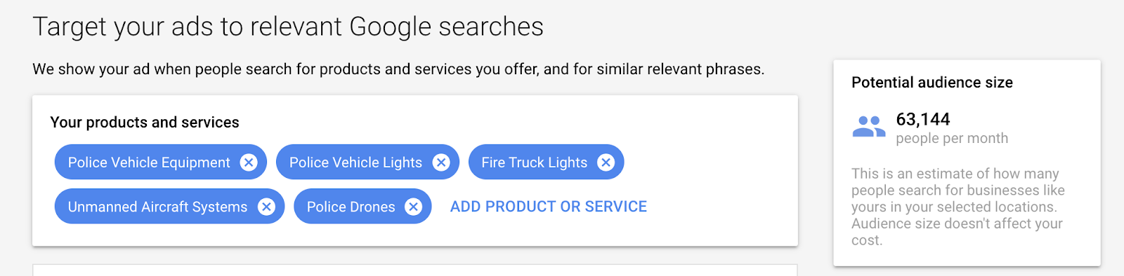
Market interest and Potential Commercial Markets
Market Identification
“Over 50k searches”
Market Understanding
Market infancy
Slow but steady adoption
Police Department enthusiasm
Market Evaluation
Market is not mature and is still in its growth phase.

Slide 10
Future Scope of Technology
Aim
Licensing or selling the technology
Customers
First responders, defense, insurance companies, inter-state truckers
Potential partners:
Axon (camera technology), Verizon (network bandwidth)

Slide 11
Barriers to Entry
Existing drone programs
Time to manufacture
Technical challenges
Critical user testing is still pending
Privacy concern

Slide 12

Recommendation
customers survey
Budget
Proven expertise
Risks
No user testing
Security
Next steps
Find licenser or partner

Slide 13
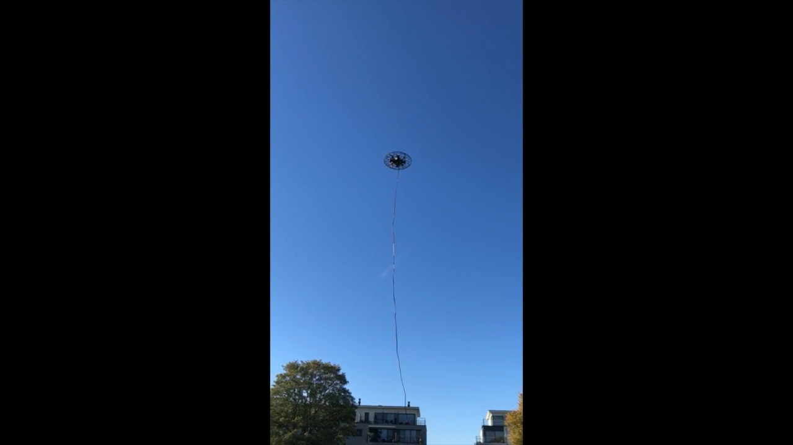
Prototype

Slide 14
Thank You!
Questions

